Slide 1
Transforming ER/EER Diagrams into Relations

Slide 2
Lecture - Objectives
Mapping Regular Entity into Relation
Map Weak Entities into Relation
Map Binary Relationships
One-to-Many
Many-to-Many
One-to-One
Map Associative Entities

Slide 3
Transforming ER Diagrams into Relations
Mapping Regular Entities to Relations:
Simple attributes: E-R attributes map directly onto the relation
Composite attributes: Use only their simple, component attributes
Multivalued Attribute: Becomes a separate relation with a foreign key taken from the superior entity

Slide 4


Figure 5-8 Mapping a regular entity
(a) CUSTOMER entity type with simple attributes
(b) CUSTOMER relation

Slide 5


Figure 5-9 Mapping a composite attribute
(a) CUSTOMER entity type with composite attribute
(b) CUSTOMER relation with address detail

Slide 6

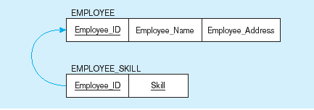
Figure 5-10 Mapping an entity with a multivalued attribute
(a)
Multivalued attribute becomes a separate relation with foreign key
(b)
One–to–many relationship between original entity and new relation

Slide 7
Transforming ER Diagrams into Relations (cont.)
Mapping Weak Entities
Becomes a separate relation with a foreign key taken from the superior entity
Primary key composed of:
Partial identifier of weak entity
Primary key of identifying relation (strong entity)

Slide 8
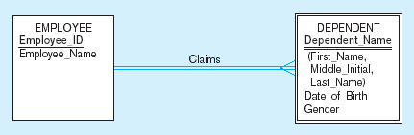
Figure 5-11 Example of mapping a weak entity
a) Weak entity DEPENDENT

Slide 9
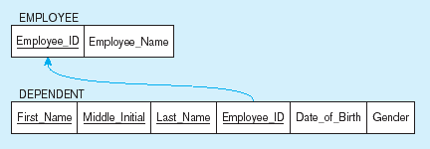
Figure 5-11 Example of mapping a weak entity (cont.)
b) Relations resulting from weak entity
NOTE: the domain constraint for the foreign key should NOT allow null value if DEPENDENT is a weak entity
Foreign key
Composite primary key

Slide 10
Transforming ER Diagrams into Relations (cont.)
Mapping Binary Relationships
One-to-Many – Primary key on the one side becomes a foreign key on the many side
Many-to-Many – Create a new relation with the primary keys of the two entities as its primary key
One-to-One – Primary key on the mandatory side becomes a foreign key on the optional side

Slide 11
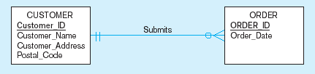
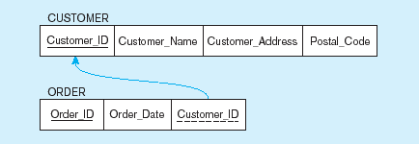
Figure 5-12 Example of mapping a 1:M relationship
a) Relationship between customers and orders
Note the mandatory one
b) Mapping the relationship
Again, no null value in the foreign key…this is because of the mandatory minimum cardinality
Foreign key

Slide 12
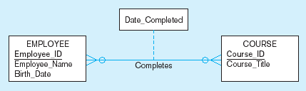
Figure 5-13 Example of mapping an M:N relationship
a) Completes relationship (M:N)
The Completes relationship will need to become a separate relation

Slide 13
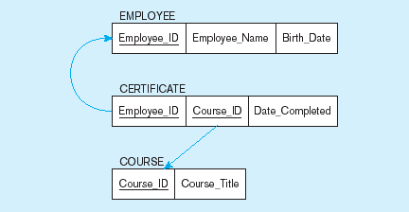
Figure 5-13 Example of mapping an M:N relationship (cont.)
b) Three resulting relations
Composite primary key
Foreign key
New intersection relation
Foreign key

Slide 14
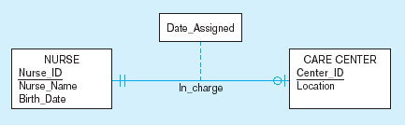
Figure 5-14 Example of mapping a binary 1:1 relationship
a) In_charge relationship (1:1)
Often in 1:1 relationships, one direction is optional.

Slide 15
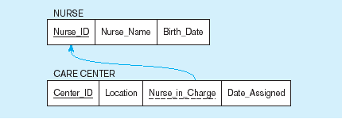
Figure 5-14 Example of mapping a binary 1:1 relationship (cont.)
b) Resulting relations
Foreign key goes in the relation on the optional side,
Matching the primary key on the mandatory side

Slide 16
Transforming ER Diagrams into Relations (cont.)
Mapping Associative Entities
Identifier Not Assigned
Default primary key for the association relation is composed of the primary keys of the two entities (as in M:N relationship)
Identifier Assigned
It is a natural single-attribute identifier that is familiar to end-users.
Default identifier (consisting of the identifiers for each of the participating entity types) may not be unique

Slide 17
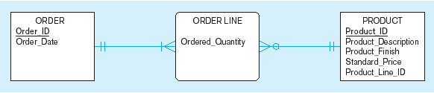
Figure 5-15 Example of mapping an associative entity
a) An associative entity

Slide 18
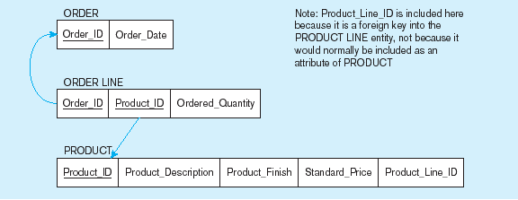
Figure 5-15 Example of mapping an associative entity (cont.)
b) Three resulting relations
Composite primary key formed from the two foreign keys

Slide 19

Figure 5-16 Example of mapping an associative entity with
an identifier
a) SHIPMENT associative entity

Slide 20
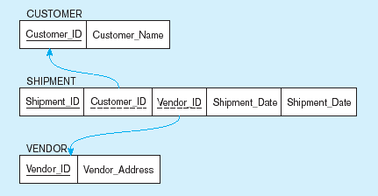
Figure 5-16 Example of mapping an associative entity with
an identifier (cont.)
b) Three resulting relations
Primary key differs from foreign keys

Slide 21
Thanks

